Slide 1
Chapter 3: Processes

Slide 2
Three/Four Key Components of an OS
1. Process Management
2. Memory Management
3. Storage Management
3.5 I/O Systems

Slide 3
Objectives
To introduce the notion of a process -- a program in execution, which forms the basis of all computation
To describe the various features of processes, including scheduling, creation and termination, and communication
To explore interprocess communication using shared memory and message passing
To describe communication in client-server systems

Slide 4
Chapter 3: Processes
Process Concept
Process Scheduling
Operations on Processes
Interprocess Communication
Examples of IPC Systems
Communication in Client-Server Systems

Slide 5
3.1 Process Concept
An operating system executes a variety of programs:
Batch system – jobs
Time-shared systems – user programs or tasks
Textbook uses the terms job and process almost interchangeably
Process – a program in execution; process execution must progress in sequential fashion
Multiple parts
Text section：The program code
Data section： containing global variables
Program counter：
Stack： containing temporary data
Function parameters, return addresses, local variables
Heap： containing memory dynamically allocated during run time

Slide 6
Process Concept (Cont.)
Program is passive entity stored on disk (executable file), process is active
Program becomes process when executable file loaded into memory
Execution of program started via GUI mouse clicks, command line entry of its name, etc
One program can be several processes
Consider multiple users executing the same program

Slide 7
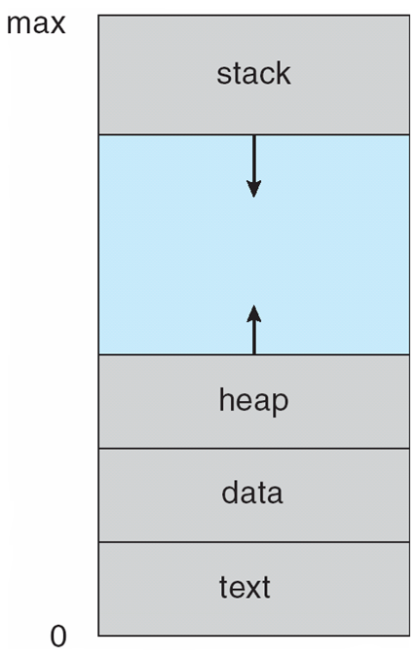
Process in Memory

Slide 8
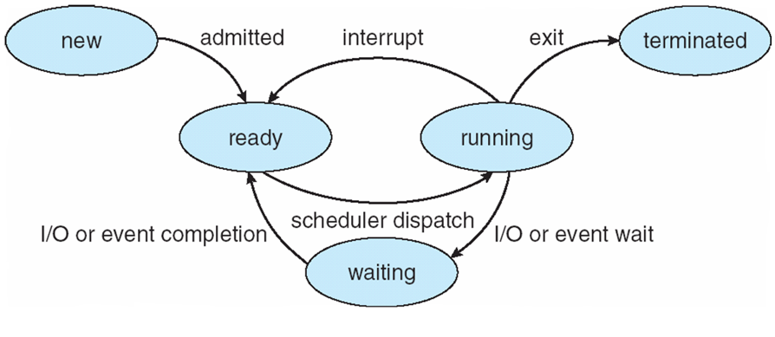
Process State 1/2
As a process executes, it changes state
new: The process is being created
running: Instructions are being executed
waiting(blocking): The process is waiting for some event to occur
ready: The process is waiting to be assigned to a processor
terminated: The process has finished execution

Slide 9
Process State 2/2

Slide 10
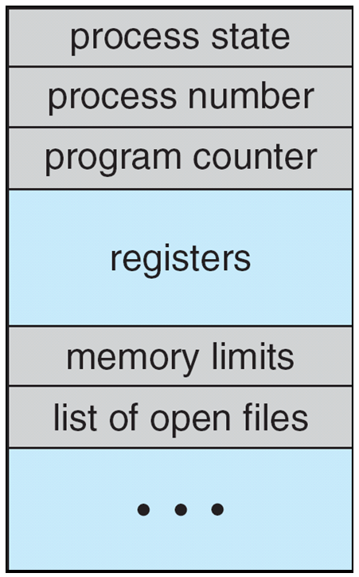
Process Control Block (PCB)
Information associated with each process
(also called task control block)
Process state – running, waiting, etc
Process identifier(PID) – usually a unique number
Program counter – location of instruction to next execute
CPU registers – contents of all process-centric registers
CPU scheduling information- priorities, scheduling queue pointers
Memory-management information – memory allocated to the process
Accounting information – CPU used, clock time elapsed since start, time limits
I/O status information – I/O devices allocated to process, list of open files

Slide 11
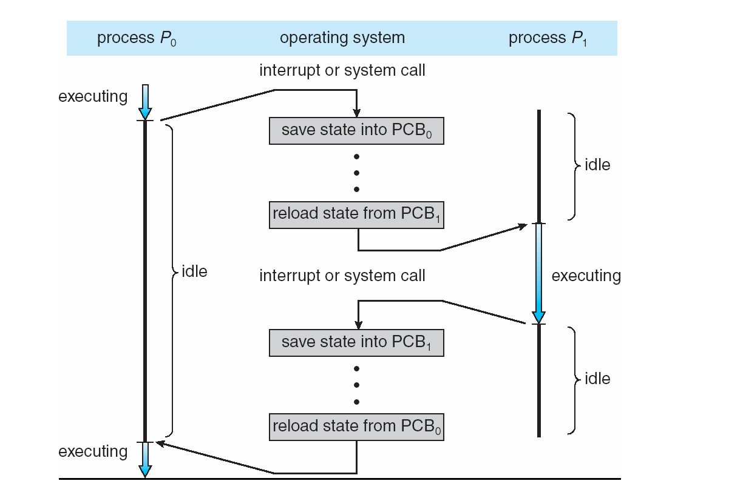
CPU Switch From Process to Process

Slide 12
Threads
So far, process has a single thread of execution
Consider having multiple program counters per process
Multiple locations can execute at once
Multiple threads of control -> threads
Must then have storage for thread details, multiple program counters in PCB
See next chapter

Slide 13
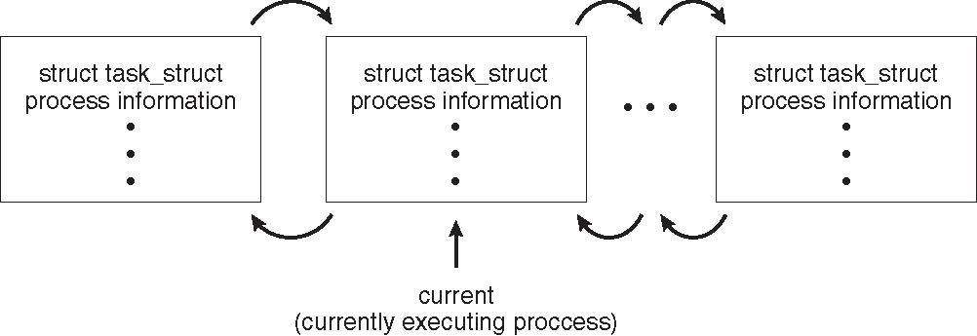
*Process Representation in Linux
Represented by the C structure task_struct
pid t_pid; /* process identifier */ long state; /* state of the process */ unsigned int time_slice /* scheduling information */ struct task_struct *parent; /* this process’s parent */ struct list_head children; /* this process’s children */ struct files_struct *files; /* list of open files */ struct mm_struct *mm; /* address space of this process */

Slide 14
3.2 Process Scheduling
The objective of multiprogramming is to have some process running at all times, to maximize CPU utilization. Quickly switch processes onto CPU for time sharing
The objective of time sharing is to switch the CPU among processes so frequently that users can interact with each program while it is running.
Process scheduler selects among available processes for next execution on CPU
For a single-processor system, there will never be more than one running process. If there are more processes, the rest will have to wait until the CPU is free and can be rescheduled.
Maintains scheduling queues of processes
Job queue – set of all processes in the system
Ready queue – set of all processes residing in main memory, ready and waiting to execute
Device queues – set of processes waiting for an I/O device
Processes migrate among the various queues

Slide 15
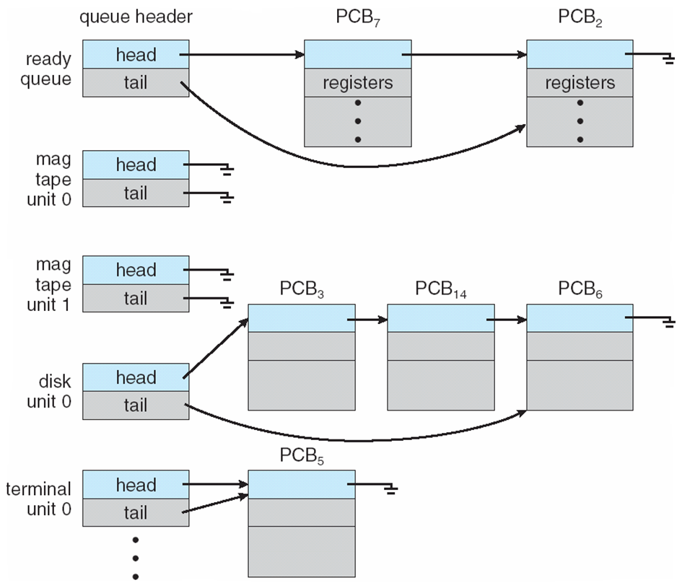
Ready Queue And Various I/O Device Queues

Slide 16
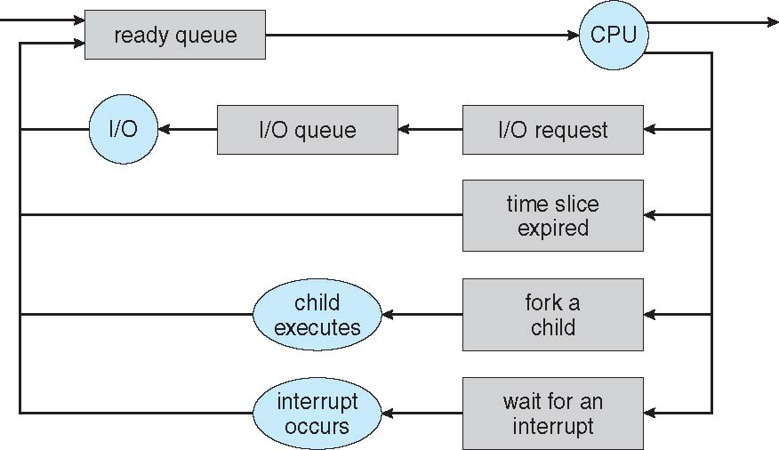
Representation of Process Scheduling
Queueing diagram represents queues, resources, flows

Slide 17
Schedulers
Short-term scheduler (or CPU scheduler) – selects which process should be executed next and allocates CPU
Sometimes the only scheduler in a system
Short-term scheduler is invoked frequently (milliseconds) ⇒ (must be fast)
Long-term scheduler (or job scheduler) – selects which processes should be brought into the ready queue
Long-term scheduler is invoked infrequently (seconds, minutes) ⇒ (may be slow)
The long-term scheduler controls the degree of multiprogramming
Processes can be described as either:
I/O-bound process – spends more time doing I/O than computations, many short CPU bursts
CPU-bound process – spends more time doing computations; few very long CPU bursts
Long-term scheduler strives for good process mix

Slide 18
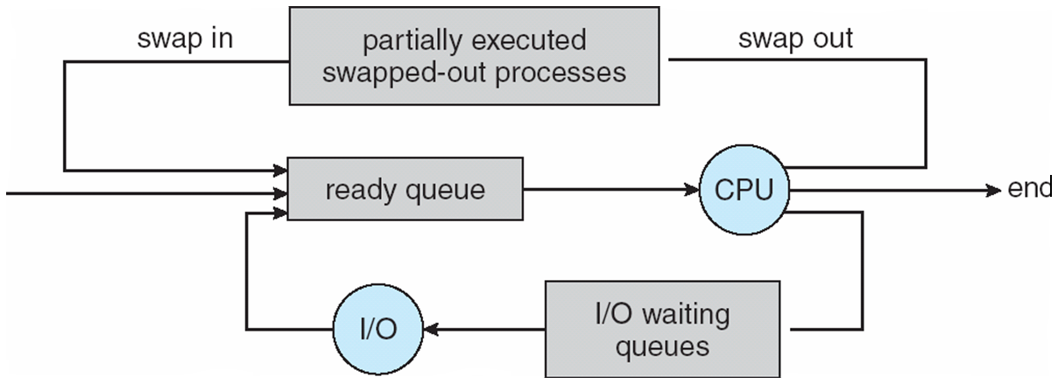
Addition of Medium Term Scheduling
Medium-term scheduler can be added if degree of multiple programming needs to decrease
Remove process from memory, store on disk, bring back in from disk to continue execution: swapping

Slide 19
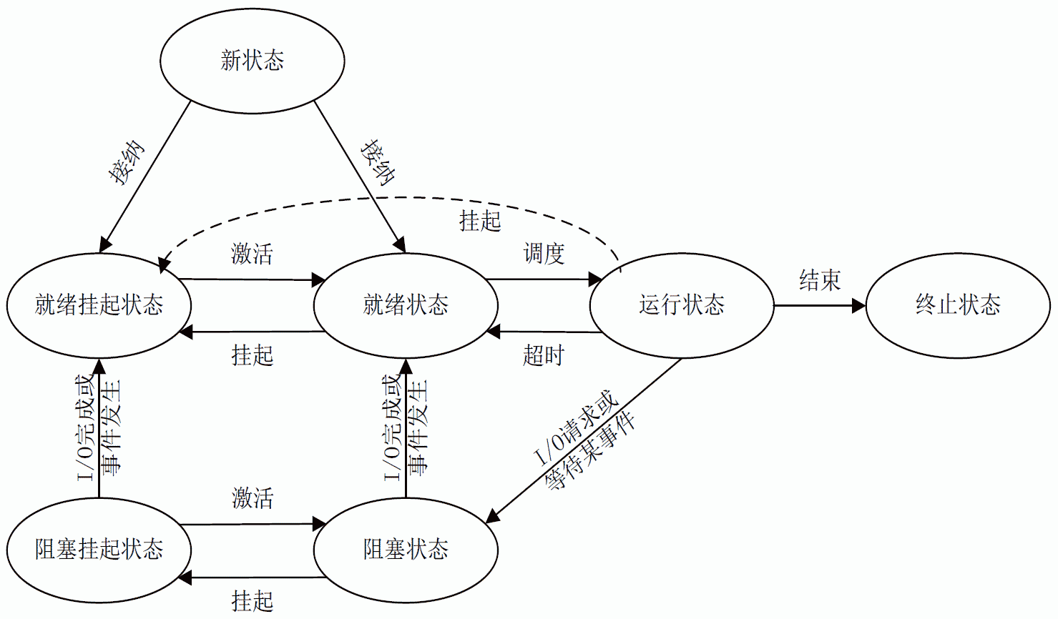
Process State with Suspend
被挂起的进程被暂存在磁盘上，用于节省内存空间。
挂起： Suspend
激活： Activate

Slide 20
Multitasking in Mobile Systems
Some mobile systems (e.g., early version of iOS) allow only one process to run, others suspended
Due to screen real estate, user interface limits iOS provides for a
Single foreground process- controlled via user interface
Multiple background processes– in memory, running, but not on the display, and with limits
Limits include single, short task, receiving notification of events, specific long-running tasks like audio playback
Android runs foreground and background, with fewer limits
Background process uses a service to perform tasks
Service can keep running even if background process is suspended
Service has no user interface, small memory use

Slide 21
Context Switch
When CPU switches to another process, the system must save the state of the old process and load the saved state for the new process via a context switch
Context of a process represented in the PCB
Context-switch time is overhead; the system does no useful work while switching
The more complex the OS and the PCB ➔ the longer the context switch
Time dependent on hardware support
Some hardware provides multiple sets of registers per CPU ➔ multiple contexts loaded at once

Slide 22
3.3 Operations on Processes
System must provide mechanisms for:
process creation,
process termination,
and so on as detailed next

Slide 23
Process Creation
Parent process create children processes, which, in turn create other processes, forming a tree of processes
Generally, process identified and managed via a process identifier (pid)
Resource sharing options
Parent and children share all resources
Children share subset of parent’s resources
Parent and child share no resources
Execution options
Parent and children execute concurrently
Parent waits until children terminate

Slide 24
A Tree of Processes in Linux

Slide 25
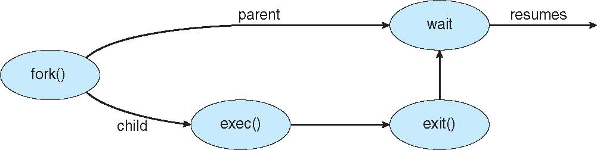
Process Creation (Cont.)
Address space
Child duplicate of parent
Child has a program loaded into it
UNIX examples
fork() system call creates new process
exec() system call used after a fork() to replace the process’ memory space with a new program

Slide 26
C Program Forking Process 1
#include <sys/types.h>
#include <stdio.h>
#include <unistd.h>
int main() {
pid_t pid;
printf("I am parent, no child now\n");
pid = fork(); /* fork a child process */
if (pid < 0) { /* error occurred */
fprintf(stderr, "Fork failed\n");
return 1;
}
else if (pid == 0) /* child process */
printf("I am child\n");
else { /* parent process */
/* parent wait for child to complete */
wait(NULL);
printf("Child complete\n");
}
return 0;
}

Slide 27
C Program Forking Process 2
#include <sys/types.h>
#include <stdio.h>
#include <unistd.h>
int main() {
pid_t pid;
printf("I am parent, no child now\n");
pid = fork(); /* fork a child process */
if (pid < 0) { /* error occurred */
fprintf(stderr, "Fork failed\n");
return 1;
}
else if (pid == 0) /* child process */
printf("I am child\n");
else { /* parent process */
/* parent wait for child to complete */
wait(NULL);
printf("Child complete\n");
}
return 0;
}

Slide 28
C Program Forking Process 3
#include <sys/types.h>
#include <stdio.h>
#include <unistd.h>
int main() {
pid_t pid;
printf("I am parent, no child now\n");
pid = fork(); /* fork a child process */
if (pid < 0) { /* error occurred */
fprintf(stderr, "Fork failed\n");
return 1;
}
else if (pid == 0) /* child process */
printf("I am child\n");
else { /* parent process */
/* parent wait for child to complete */
wait(NULL);
printf("Child complete\n");
}
return 0;
}

Slide 29
C Program Forking Process 4
#include <sys/types.h>
#include <stdio.h>
#include <unistd.h>
int main() {
pid_t pid;
printf("I am parent, no child now\n");
pid = fork(); /* fork a child process */
if (pid < 0) { /* error occurred */
fprintf(stderr, "Fork failed\n");
return 1;
}
else if (pid == 0) /* child process */
printf("I am child\n");
else { /* parent process */
/* parent wait for child to complete */
wait(NULL);
printf("Child complete\n");
}
return 0;
}

Slide 30
C Program Forking Process 5
#include <sys/types.h>
#include <stdio.h>
#include <unistd.h>
int main() {
pid_t pid;
printf("I am parent, no child now\n");
pid = fork(); /* fork a child process */
if (pid < 0) { /* error occurred */
fprintf(stderr, "Fork failed\n");
return 1;
}
else if (pid == 0) /* child process */
printf("I am child\n");
else { /* parent process */
/* parent wait for child to complete */
wait(NULL);
printf("Child complete\n");
}
return 0;
}
#include <sys/types.h>
#include <stdio.h>
#include <unistd.h>
int main() {
pid_t pid; // 浅蓝色部分为子进程宛如已执行
printf("I am parent, no child now\n");
pid = fork(); /* fork a child process */
if (pid < 0) { /* error occurred */
fprintf(stderr, "Fork failed\n");
return 1;
}
else if (pid == 0) /* child process */
printf("I am child\n");
else { /* parent process */
/* parent wait for child to complete */
wait(NULL);
printf("Child complete\n");
}
return 0;
}
Parent
Child

Slide 31
C Program Forking Process 5
#include <sys/types.h>
#include <stdio.h>
#include <unistd.h>
int main() {
pid_t pid;
printf("I am parent, no child now\n");
pid = fork(); /* fork a child process */
if (pid < 0) { /* error occurred */
fprintf(stderr, "Fork failed\n");
return 1;
}
else if (pid == 0) /* child process */
printf("I am child\n");
else { /* parent process */
/* parent wait for child to complete */
wait(NULL);
printf("Child complete\n");
}
return 0;
}
#include <sys/types.h>
#include <stdio.h>
#include <unistd.h>
int main() {
pid_t pid; // 浅蓝色部分为子进程宛如已执行
printf("I am parent, no child now\n");
pid = fork(); /* fork a child process */
if (pid < 0) { /* error occurred */
fprintf(stderr, "Fork failed\n");
return 1;
}
else if (pid == 0) /* child process */
printf("I am child\n");
else { /* parent process */
/* parent wait for child to complete */
wait(NULL);
printf("Child complete\n");
}
return 0;
}
Parent
Child

Slide 32
C Program Forking Process 6
#include <sys/types.h>
#include <stdio.h>
#include <unistd.h>
int main() {
pid_t pid;
printf("I am parent, no child now\n");
pid = fork(); /* fork a child process */
if (pid < 0) { /* error occurred */
fprintf(stderr, "Fork failed\n");
return 1;
}
else if (pid == 0) /* child process */
printf("I am child\n");
else { /* parent process */
/* parent wait for child to complete */
wait(NULL);
printf("Child complete\n");
}
return 0;
}
#include <sys/types.h>
#include <stdio.h>
#include <unistd.h>
int main() {
pid_t pid; // 浅蓝色部分为子进程宛如已执行
printf("I am parent, no child now\n");
pid = fork(); /* fork a child process */
if (pid < 0) { /* error occurred */
fprintf(stderr, "Fork failed\n");
return 1;
}
else if (pid == 0) /* child process */
printf("I am child\n");
else { /* parent process */
/* parent wait for child to complete */
wait(NULL);
printf("Child complete\n");
}
return 0;
}
Parent
Child

Slide 33
C Program Forking Process 7
#include <sys/types.h>
#include <stdio.h>
#include <unistd.h>
int main() {
pid_t pid;
printf("I am parent, no child now\n");
pid = fork(); /* fork a child process */
if (pid < 0) { /* error occurred */
fprintf(stderr, "Fork failed\n");
return 1;
}
else if (pid == 0) /* child process */
printf("I am child\n");
else { /* parent process */
/* parent wait for child to complete */
wait(NULL);
printf("Child complete\n");
}
return 0;
}
#include <sys/types.h>
#include <stdio.h>
#include <unistd.h>
int main() {
pid_t pid; // 浅蓝色部分为子进程宛如已执行
printf("I am parent, no child now\n");
pid = fork(); /* fork a child process */
if (pid < 0) { /* error occurred */
fprintf(stderr, "Fork failed\n");
return 1;
}
else if (pid == 0) /* child process */
printf("I am child\n");
else { /* parent process */
/* parent wait for child to complete */
wait(NULL);
printf("Child complete\n");
}
return 0;
}
Parent
Child

Slide 34
C Program Forking Process 8
#include <sys/types.h>
#include <stdio.h>
#include <unistd.h>
int main() {
pid_t pid;
printf("I am parent, no child now\n");
pid = fork(); /* fork a child process */
if (pid < 0) { /* error occurred */
fprintf(stderr, "Fork failed\n");
return 1;
}
else if (pid == 0) /* child process */
printf("I am child\n");
else { /* parent process */
/* parent wait for child to complete */
wait(NULL);
printf("Child complete\n");
}
return 0;
}
#include <sys/types.h>
#include <stdio.h>
#include <unistd.h>
int main() {
pid_t pid; // 浅蓝色部分为子进程宛如已执行
printf("I am parent, no child now\n");
pid = fork(); /* fork a child process */
if (pid < 0) { /* error occurred */
fprintf(stderr, "Fork failed\n");
return 1;
}
else if (pid == 0) /* child process */
printf("I am child\n");
else { /* parent process */
/* parent wait for child to complete */
wait(NULL);
printf("Child complete\n");
}
return 0;
}
Parent
Child

Slide 35
C Program Forking Process 9
#include <sys/types.h>
#include <stdio.h>
#include <unistd.h>
int main() {
pid_t pid;
printf("I am parent, no child now\n");
pid = fork(); /* fork a child process */
if (pid < 0) { /* error occurred */
fprintf(stderr, "Fork failed\n");
return 1;
}
else if (pid == 0) /* child process */
printf("I am child\n");
else { /* parent process */
/* parent wait for child to complete */
wait(NULL);
printf("Child complete\n");
}
return 0;
}
#include <sys/types.h>
#include <stdio.h>
#include <unistd.h>
int main() {
pid_t pid; // 浅蓝色部分为子进程宛如已执行
printf("I am parent, no child now\n");
pid = fork(); /* fork a child process */
if (pid < 0) { /* error occurred */
fprintf(stderr, "Fork failed\n");
return 1;
}
else if (pid == 0) /* child process */
printf("I am child\n");
else { /* parent process */
/* parent wait for child to complete */
wait(NULL);
printf("Child complete\n");
}
return 0;
}
Parent
Child

Slide 36
C Program Forking Process 10
#include <sys/types.h>
#include <stdio.h>
#include <unistd.h>
int main() {
pid_t pid;
printf("I am parent, no child now\n");
pid = fork(); /* fork a child process */
if (pid < 0) { /* error occurred */
fprintf(stderr, "Fork failed\n");
return 1;
}
else if (pid == 0) /* child process */
printf("I am child\n");
else { /* parent process */
/* parent wait for child to complete */
wait(NULL);
printf("Child complete\n");
}
return 0;
}
#include <sys/types.h>
#include <stdio.h>
#include <unistd.h>
int main() {
pid_t pid; // 浅蓝色部分为子进程宛如已执行
printf("I am parent, no child now\n");
pid = fork(); /* fork a child process */
if (pid < 0) { /* error occurred */
fprintf(stderr, "Fork failed\n");
return 1;
}
else if (pid == 0) /* child process */
printf("I am child\n");
else { /* parent process */
/* parent wait for child to complete */
wait(NULL);
printf("Child complete\n");
}
return 0;
}
Parent
Child

Slide 37
C Program Forking Process 11
#include <sys/types.h>
#include <stdio.h>
#include <unistd.h>
int main() {
pid_t pid;
printf("I am parent, no child now\n");
pid = fork(); /* fork a child process */
if (pid < 0) { /* error occurred */
fprintf(stderr, "Fork failed\n");
return 1;
}
else if (pid == 0) /* child process */
printf("I am child\n");
else { /* parent process */
/* parent wait for child to complete */
wait(NULL);
printf("Child complete\n");
}
return 0;
}
#include <sys/types.h>
#include <stdio.h>
#include <unistd.h>
int main() {
pid_t pid; // 浅蓝色部分为子进程宛如已执行
printf("I am parent, no child now\n");
pid = fork(); /* fork a child process */
if (pid < 0) { /* error occurred */
fprintf(stderr, "Fork failed\n");
return 1;
}
else if (pid == 0) /* child process */
printf("I am child\n");
else { /* parent process */
/* parent wait for child to complete */
wait(NULL);
printf("Child complete\n");
}
return 0;
}
Parent
Child

Slide 38
C Program Forking Process 12
#include <sys/types.h>
#include <stdio.h>
#include <unistd.h>
int main() {
pid_t pid;
printf("I am parent, no child now\n");
pid = fork(); /* fork a child process */
if (pid < 0) { /* error occurred */
fprintf(stderr, "Fork failed\n");
return 1;
}
else if (pid == 0) /* child process */
printf(“I am child\n");
else { /* parent process */
/* parent wait for child to complete */
wait(NULL);
printf("Child complete\n");
}
return 0;
}
#include <sys/types.h>
#include <stdio.h>
#include <unistd.h>
int main() {
pid_t pid; // 浅蓝色部分为子进程宛如已执行
printf("I am parent, no child now\n");
pid = fork(); /* fork a child process */
if (pid < 0) { /* error occurred */
fprintf(stderr, "Fork failed\n");
return 1;
}
else if (pid == 0) /* child process */
printf(“I am child\n");
else { /* parent process */
/* parent wait for child to complete */
wait(NULL);
printf("Child complete\n");
}
return 0;
}
Parent
Child

Slide 39
C Program Forking Process 13
#include <sys/types.h>
#include <stdio.h>
#include <unistd.h>
int main() {
pid_t pid;
printf("I am parent, no child now\n");
pid = fork(); /* fork a child process */
if (pid < 0) { /* error occurred */
fprintf(stderr, "Fork failed\n");
return 1;
}
else if (pid == 0) /* child process */
printf(“I am child\n");
else { /* parent process */
/* parent wait for child to complete */
wait(NULL);
printf("Child complete\n");
}
return 0;
}
#include <sys/types.h>
#include <stdio.h>
#include <unistd.h>
int main() {
pid_t pid; // 浅蓝色部分为子进程宛如已执行
printf("I am parent, no child now\n");
pid = fork(); /* fork a child process */
if (pid < 0) { /* error occurred */
fprintf(stderr, "Fork failed\n");
return 1;
}
else if (pid == 0) /* child process */
printf(“I am child\n");
else { /* parent process */
/* parent wait for child to complete */
wait(NULL);
printf("Child complete\n");
}
return 0;
}
Parent
Child

Slide 40
C Program Forking Process 14
#include <sys/types.h>
#include <stdio.h>
#include <unistd.h>
int main() {
pid_t pid;
printf("I am parent, no child now\n");
pid = fork(); /* fork a child process */
if (pid < 0) { /* error occurred */
fprintf(stderr, "Fork failed\n");
return 1;
}
else if (pid == 0) /* child process */
printf("I am child\n");
else { /* parent process */
/* parent wait for child to complete */
wait(NULL);
printf("Child complete\n");
}
return 0;
}
#include <sys/types.h>
#include <stdio.h>
#include <unistd.h>
int main() {
pid_t pid; // 浅蓝色部分为子进程宛如已执行
printf("I am parent, no child now\n");
pid = fork(); /* fork a child process */
if (pid < 0) { /* error occurred */
fprintf(stderr, "Fork failed\n");
return 1;
}
else if (pid == 0) /* child process */
printf("I am child\n");
else { /* parent process */
/* parent wait for child to complete */
wait(NULL);
printf("Child complete\n");
}
return 0;
}
Parent
Child

Slide 41
C Program Forking Process 15
#include <sys/types.h>
#include <stdio.h>
#include <unistd.h>
int main() {
pid_t pid; // 蓝色部分先执行
printf("I am parent, no child now\n");
pid = fork(); /* fork a child process */
if (pid < 0) { /* error occurred */
fprintf(stderr, "Fork failed\n");
return 1;
}
else if (pid == 0) /* child process */
printf("I am child\n");
else { /* parent process */
/* parent wait for child to complete */
wait(NULL);
printf("Child complete\n");
}
return 0; // 紫色部分在红色部分之后执行
}
#include <sys/types.h>
#include <stdio.h>
#include <unistd.h>
int main() {
pid_t pid; // 浅蓝色部分为子进程宛如已执行
printf("I am parent, no child now\n");
pid = fork(); /* fork a child process */
if (pid < 0) { /* error occurred */
fprintf(stderr, "Fork failed\n");
return 1;
}
else if (pid == 0) /* child process */
printf("I am child\n");
else { /* parent process */
/* parent wait for child to complete */
wait(NULL);
printf("Child complete\n");
}
return 0; // 红/绿部分执行顺序看调度情况
}
Parent
Child

Slide 42
C Program Forking Separate Process
#include <sys/types.h>
#include <stdio.h>
#include <unistd.h>
int main() {
pid_t pid;
pid = fork(); /* fork a child process */
if (pid < 0) { /* error occurred */
fprintf(stderr, "Fork failed\n");
return 1;
}
else if (pid == 0) /* child process */
execlp(“ls”, “ls”, “/”, (char *)NULL);
else { /* parent process */
/* parent will wait for the child to complete */
wait(NULL);
printf("Child complete\n");
}
return 0;
}

Slide 43
How Many Processes are Created?
int main() { /* multi-fork.c */
printf("%d*\n", getpid());
fork();
printf("%d**\n", getpid());
fork();
printf("%d***\n", getpid());
fork();
printf("%d****\n", getpid());
sleep(15);
return 0; }

Slide 44
Terminal Display
2725*
2725**
2725***
2727***
2725****
2726**
2727****
2728****
2726***
2726****
2731****
2729****
2730***
2730****
2732****

Slide 45
ps –el Command Display(Another Terminal)
F S UID PID PPID C PRI NI ADDR SZ WCHAN TTY TIME CMD
…
0 S 1000 2725 2083 0 80 0 - 624 hrtime pts/0 00:00:00 multi-fork
1 S 1000 2726 2725 0 80 0 - 624 hrtime pts/0 00:00:00 multi-fork
1 S 1000 2727 2725 0 80 0 - 624 hrtime pts/0 00:00:00 multi-fork
1 S 1000 2728 2725 0 80 0 - 624 hrtime pts/0 00:00:00 multi-fork
1 S 1000 2729 2727 0 80 0 - 624 hrtime pts/0 00:00:00 multi-fork
1 S 1000 2730 2726 0 80 0 - 624 hrtime pts/0 00:00:00 multi-fork
1 S 1000 2731 2726 0 80 0 - 624 hrtime pts/0 00:00:00 multi-fork
1 S 1000 2732 2730 0 80 0 - 624 hrtime pts/0 00:00:00 multi-fork
0 R 1000 2733 2569 0 80 0 - 5013 - pts/1 00:00:00 ps
除了启动的第1个multi-fork，还fork出了7个子进程，因此共显示了8个multi-fork进程

Slide 46
Processes Tree of multi-fork
2725 2726 2730 2732
2731
2727 2729
2728

Slide 47
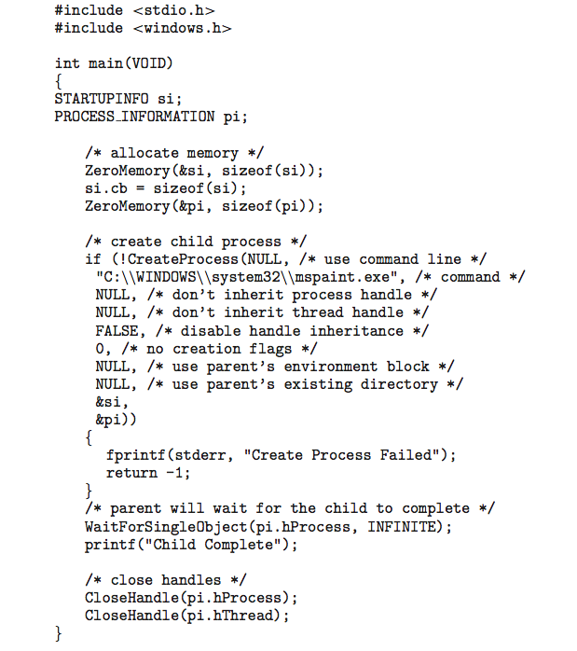
Creating a Separate Process via Windows API

Slide 48
Data, Stack and Heap in Forked Process 1/2
int d_var = 1;
int main(void) { /* fork_dsh.c， w/o #include <*.h> */
pid_t pid; int s_var = 2;
int* h = (int *)malloc(sizeof(int)); *h = 3;
pid = fork();
if (pid == 0) { /* Child process */
sleep(3); /* Wait parent run. Not reliable, for demo only! */
d_var += 100; s_var += 100; *h += 100;
printf ("Child: d_var=%d, s_var=%d, *h=%d\n", d_var, s_var, *h); }
else if (pid > 0) { /* Parent process */
d_var += 10; s_var += 10; *h += 10;
wait(NULL); /* Wait child exit */
printf ("Parent: d_var=%d, s_var=%d, *h=%d\n", d_var, s_var, *h); }
free(h);
return 0; }
Notes:
为了写在一页内，省略了前面的#include 头文件部分，另外格式上紧凑但不正规

Slide 49
Data, Stack and Heap in Forked Process 2/2
u1@ubuntu:~$ ./fork_dsh
Child: d_var=101, s_var=102, *h=103
Parent: d_var=11, s_var=12, *h=13
运行结果表明：
1. fork()后，子进程除了复制了父进程的代码，也复制了全局数据、栈及堆的内容，这从子进程中 d_var, s_var, *h这三个变量的初始值分别为1，2，3可以看出
2. fork()后，不管父子进程哪一方修改全局数据、栈及堆的内容，均不影响对方那一份的值
事实上，fork()后，父子进程共享同一个内存空间(逻辑上两个内存进程空间，实际上指向同一个物理空间)，但被系统标记为“只读”。当父子进程之一有写入某一段的行为发生时，再为子进程分配物理空间，并进行实际复制操作后再进行写入。
这种技术称为“写时复制”(Copy on Write)

Slide 50
Fork() & Copy on Write(CoW)
fork()后，子进程复制了父进程的几乎所有一切(除了fork函数的返回值，当然各有自己的PCB，其PID，父进程PID等也不同)，但仍共用一个内存空间，也就是内存空间的复制只是逻辑上的，而非物理上的，并没有实际复制内存空间。
虽然CoW或exec()前共用一个内存空间，但父子进程间已“貌合神离”，一旦任何一方有风吹草动(写入内存空间的动作，包括写入全局数据、栈、堆)，都会进行实际的复制。
之所以在fork()后，系统不自动复制内存空间，是因为子进程可能会马上调用exec()，用另外的程序覆盖内存空间，那样exec()前的物理复制就是多余的耗时操作了。

Slide 51
Process Termination 1/2
Process executes last statement and then asks the operating system to delete it using the exit() system call.
Returns status data from child to parent (via wait())
Process’ resources are deallocated by operating system
Parent may terminate the execution of children processes via an appropriate system call(for example, TerminateProcess() in Windows). Some reasons for doing so:
Child has exceeded allocated resources
Task assigned to child is no longer required
The parent is exiting and the operating systems does not allow a child to continue if its parent terminates

Slide 52
Process Termination 2/2
Some operating systems do not allow child to exists if its parent has terminated. If a process terminates, then all its children must also be terminated.
cascading termination(级联终止). All children, grandchildren, etc. are terminated.
The termination is initiated by the operating system.
The parent process may wait for termination of a child process by using the wait()system call. The call returns status information and the pid of the terminated process
pid = wait(&status);
If no parent waiting (did not invoke wait()) process is a zombie(僵尸进程)
If parent terminated without invoking wait , process is an orphan(孤儿进程). Some OS may changes the process’ parent to a system process.

Slide 53
Cascading Termination in Linux?
int main(void) { /* fork_pexit.c， w/o #include <*.h> */
pid_t pid = fork(); /* fork a child process */
if (pid < 0) { /* error occurred */
fprintf(stderr, "Fork failed\n");
exit(-1); }
else if (pid == 0) { /* child process */
printf("I am the child. My PID is %d, my parent's PID is %d\n", getpid(), getppid());
sleep(5); /* Wait parent run. Not reliable, for demo only! */
printf("Wake up. My PID is %d, my parent's PID is %d\n", getpid(), getppid());
execlp(“ls”, “ls”, (char *)NULL);
printf("Unreachable 1!\n"); }
else { /* parent process */
printf("I am the parent. My PID is %d, my child's PID is %d\n", getpid(), pid);
sleep(1); /* Wait child run. Not reliable, for demo only! */
exit(0);
printf("Unreachable 2!\n"); }
printf("Unreachable 3!\n"); return 0; }
Notes:
注：省略了include头文件. 为了显示在一页，C语言格式不规范

Slide 54
Running Output in Linux(Ubuntu 20.04)
I am the parent. My PID is 2101, my child's PID is 2102
I am the child. My PID is 2102, my parent's PID is 2101
u1@ubuntu:~$ Wake up. My PID is 2102, my parent's PID is 1369
Desktop fork_execlp fork_pexit.c Music Videos
Documents fork_execlp.c hello Pictures
Downloads fork_pexit hello.c Public Templates
u1@ubuntu:~$ ps 1369
PID TTY STAT TIME COMMAND
1369 ? Ss 0:02 /lib/systemd/systemd --user

Slide 55
Create a Zombie Deliberately 1/3
#include <stdio.h>
#include <unistd.h>
#include <sys/types.h>
#include <sys/wait.h>
#include <stdlib.h>
int main(void) /* zombie.c */
{
pid_t pid, pid2;
pid = fork(); /* fork a child process */
if (pid < 0) { /* error occurred */
fprintf(stderr, "Fork failed\n");
exit(-1);
}

Slide 56
Create a Zombie Deliberately 2/3
else if (pid == 0) /* child process */
printf("I am the child. My PID is %d, my parent's PID is %d\n", getpid(), getppid());
else { /* parent process */
printf("I am the parent. My PID is %d, my child's PID is %d\n", getpid(), pid);
sleep(3); /* Wait child terminate. Not reliable, for demo only! */
/* No wait() here, to make child 1 zombie */
pid2 = fork(); /* fork 2nd child process */
if(pid2 == 0) /* 2nd child process */
execlp(“ps”, “ps”, “-Al”, (char *)NULL); // ps -Al
else /* parent process, or fork failed */
sleep(3); /* Wait ps done. Not reliable, for demo only! */
}
return 0;
}

Slide 57
Create a Zombie Deliberately 3/3
u1@ubuntu:~$ ./zombie
I am the parent. My PID is 2080, my child's PID is 2081
I am the child. My PID is 2081, my parent's PID is 2080
F S UID PID PPID C PRI NI ADDR SZ WCHAN TTY TIME CMD
4 S 0 1 0 4 80 0 - 41960 - ? 00:00:19 systemd
1 S 0 2 0 0 80 0 - 0 - ? 00:00:00 kthreadd
1 I 0 3 2 0 60 -20 - 0 - ? 00:00:00 rcu_gp
1 I 0 4 2 0 60 -20 - 0 - ? 00:00:00 rcu_par_gp
…
0 R 1000 2054 1384 9 80 0 - 205696 - ? 00:00:03 gnome-terminal-
0 S 1000 2062 2054 0 80 0 - 4812 do_wai pts/0 00:00:00 bash
0 S 1000 2080 2062 0 80 0 - 624 hrtime pts/0 00:00:00 zombie
1 Z 1000 2081 2080 0 80 0 - 0 - pts/0 00:00:00 zombie <defunct>
0 R 1000 2082 2080 0 80 0 - 5013 - pts/0 00:00:00 ps
<defunct>
Notes:
defunct - [dɪˈfʌŋkt] adj.已故的；不复存在的；灭绝的；倒闭的 n.死者；死人

Slide 58

Multiprocess Architecture – Chrome Browser
Many web browsers ran as single process (some still do)
If one web site causes trouble, entire browser can hang or crash
Google Chrome Browser is multiprocess with 3 different types of processes:
Browser process manages user interface, disk and network I/O
Renderer process renders web pages, deals with HTML, Javascript. A new renderer created for each website opened
Runs in sandbox restricting disk and network I/O, minimizing effect of security exploits
Plug-in process for each type of plug-in

Slide 59
3.4 Interprocess Communication
Processes within a system may be independent or cooperating
Cooperating process can affect or be affected by other processes, including sharing data
Reasons for cooperating processes:
Information sharing
Computation speedup
Modularity
Convenience
Cooperating processes need interprocess communication (IPC)
Two models of IPC
Shared memory
Message passing

Slide 60
Communications Models
(a) Message passing. (b) shared memory.

Slide 61
Cooperating Processes
Independent process cannot affect or be affected by the execution of another process
Cooperating process can affect or be affected by the execution of another process
Advantages of process cooperation
Information sharing
Computation speed-up
Modularity
Convenience

Slide 62
Producer-Consumer Problem
Paradigm for cooperating processes, producer process produces information that is consumed by a consumer process
unbounded-buffer places no practical limit on the size of the buffer
bounded-buffer assumes that there is a fixed buffer size

Slide 63
Bounded-Buffer – Shared-Memory Solution
Shared data
#define BUFFER_SIZE 10
typedef struct {
. . .
} item;
item buffer[BUFFER_SIZE];
int in = 0;
int out = 0;
Solution is correct, but can only use BUFFER_SIZE-1 elements

Slide 64
Bounded-Buffer – Producer
item next_produced;
while (true) {
/* produce an item in next_produced */
while (((in + 1) % BUFFER_SIZE) == out) // full
; /* do nothing */
buffer[in] = next_produced;
in = (in + 1) % BUFFER_SIZE;
}

Slide 65
Bounded Buffer – Consumer
item next_consumed;
while (true) { while (in == out) // empty
; /* do nothing */ next_consumed = buffer[out];
out = (out + 1) % BUFFER_SIZE;
/* consume the item in next_consumed */
}

Slide 66
Interprocess Communication – Shared Memory
An area of memory shared among the processes that wish to communicate
The communication is under the control of the users processes not the operating system.
Major issues is to provide mechanism that will allow the user processes to synchronize their actions when they access shared memory.
Synchronization is discussed in great details in Chapter 6: Process Synchronization.

Slide 67
Errata
OSC7 翻译版，3.4.1 P86 第二自然段：
通常将客户机当作一个生产者，而将服务器当作一个消费者。
改为：
通常将服务器当作一个生产者，而将客户机当作一个消费者。

Slide 68
Interprocess Communication – Message Passing
Mechanism for processes to communicate and to synchronize their actions
Message system – processes communicate with each other without resorting to shared variables
IPC facility provides two operations:
send(message)
receive(message)
The message size is either fixed or variable

Slide 69
Message Passing (Cont.)
If processes P and Q wish to communicate, they need to:
Establish a communication link between them
Exchange messages via send/receive
Implementation issues:
How are links established?
Can a link be associated with more than two processes?
How many links can there be between every pair of communicating processes?
What is the capacity of a link?
Is the size of a message that the link can accommodate fixed or variable?
Is a link unidirectional or bi-directional?

Slide 70
Message Passing (Cont.)
Implementation of communication link
Physical:
Shared memory
Hardware bus
Network
Logical:
Direct or indirect
Synchronous or asynchronous
Automatic or explicit buffering

Slide 71
Direct Communication - Naming
Processes must name each other explicitly:
send (P, message) – send a message to process P
receive(Q, message) – receive a message from process Q
Properties of communication link
Links are established automatically
A link is associated with exactly one pair of communicating processes
Between each pair there exists exactly one link
The link may be unidirectional, but is usually bi-directional

Slide 72
Indirect Communication - mailbox
Messages are directed and received from mailboxes (also referred to as ports)
Each mailbox has a unique id
Processes can communicate only if they share a mailbox
Properties of communication link
Link established only if processes share a common mailbox
A link may be associated with many processes
Each pair of processes may share several communication links
Link may be unidirectional or bi-directional

Slide 73
Indirect Communication
Operations
create a new mailbox (port)
send and receive messages through mailbox
destroy a mailbox
Primitives are defined as:
send(A, message) – send a message to mailbox A
receive(A, message) – receive a message from mailbox A

Slide 74
Indirect Communication
Mailbox sharing
P₁, P₂, and P₃ share mailbox A
P₁, sends; P₂ and P₃ receive
Who gets the message?
Solutions
Allow a link to be associated with at most two processes
Allow only one process at a time to execute a receive operation
Allow the system to select arbitrarily the receiver. Sender is notified who the receiver was.

Slide 75
Synchronization
Message passing may be either blocking or non-blocking
Blocking is considered synchronous
Blocking send -- the sender is blocked until the message is received
Blocking receive -- the receiver is blocked until a message is available
Non-blocking is considered asynchronous
Non-blocking send -- the sender sends the message and continue
Non-blocking receive -- the receiver receives:
A valid message, or
Null message
Different combinations possible

Slide 76
When Both send() and receive() are Blocking 1/2
We have a rendezvous(交会，集合点) between the sender and the receiver.
The solution to the producer–consumer problem becomes trivial.
The producer merely invokes the blocking send() call and waits until the message is delivered to either the receiver or the mailbox.
Likewise, when the consumer invokes receive(), it blocks until a message is available.

Slide 77
When Both send() and receive() are Blocking 2/2
Producer-consumer becomes trivial when both send() and receive() are blocking
message next_produced;
while (true) { /* produce an item in next produced */
send(next_produced);
}
message next_consumed;
while (true) {
receive(next_consumed);
/* consume the item in next consumed */
}

Slide 78
Buffering
Queue of messages attached to the link.
Implemented in one of three ways
1. Zero capacity – no messages are queued on a link. Sender must wait for receiver (rendezvous)
2. Bounded capacity – finite length of n messages Sender must wait if link full
3. Unbounded capacity – infinite length Sender never waits

Slide 79
*3.5 Examples of IPC Systems - POSIX
POSIX Shared Memory
Process first creates shared memory segment shm_fd = shm_open(name, O_CREAT | O_RDWR, 0666);
Also used to open an existing segment to share it
Set the size of the object
ftruncate(shm_fd, 4096);
Now the process could write to the shared memory
sprintf(shared_memory, "Writing to shared memory");

Slide 80
IPC POSIX Producer 1/2
#include <stdio.h>
#include <stdlib.h>
#include <string.h>
#include <fcntl.h>
#include <sys/shm.h>
#include <sys/stat.h>
#include <sys/mman.h>
int main() // OSC9 & OSC10
{
/* the size (in bytes) of shared memory object */
const int SIZE = 4096;
/* name of the shared memory object */
const char *name = "OS";
/* strings written to shared memory */
const char *message_0 = "Hello";
const char *message_1 = “ World!";
/* shared memory file descriptor */
int fd;
/* pointer to shared memory obect */
char *ptr;

Slide 81
IPC POSIX Producer 2/2
/* create the shared memory object */
fd = shm_open(name, O_CREAT | O_RDWR, 0666);
/* configure the size of the shared memory object */
ftruncate(fd, SIZE);
/* memory map the shared memory object */
ptr = (char *) \
mmap(0, SIZE, PROT_READ | PROT_WRITE, MAP_SHARED, fd, 0);
/* write to the shared memory object */
sprintf(ptr, "%s", message_0);
ptr += strlen(message_0);
sprintf(ptr, "%s", message_1);
ptr += strlen(message_1);
return 0;
} // $ gcc -o shm-posix-producer shm-posix-producer.c -lrt

Slide 82
IPC POSIX Consumer 1/2
#include <stdio.h>
#include <stdlib.h>
#include <fcntl.h>
#include <sys/shm.h>
#include <sys/stat.h>
#include <sys/mman.h>
int main() // OSC9 & OSC10
{
/* the size (in bytes) of shared memory object */
const int SIZE = 4096;
/* name of the shared memory object */
const char *name = "OS";
/* shared memory file descriptor */
int fd;
/* pointer to shared memory obect */
char *ptr;

Slide 83
IPC POSIX Consumer 2/2
/* open the shared memory object */
fd = shm_open(name, O_RDONLY, 0666);
/* memory map the shared memory object */
ptr = (char *) mmap(0, SIZE, PROT_READ | PROT_WRITE, MAP_SHARED, fd, 0);
/* read from the shared memory object */
printf("%s", (char *)ptr);
/* remove the shared memory object */
shm_unlink(name);
return 0;
} // $ gcc -o shm-posix-consumer shm-posix-consumer.c -lrt

Slide 84
Examples of IPC Systems - Mach
Mach communication is message based
Even system calls are messages
Each task gets two mailboxes at creation- Kernel and Notify
Only three system calls needed for message transfer
msg_send(), msg_receive(), msg_rpc()
Mailboxes needed for commuication, created via
port_allocate()
Send and receive are flexible, for example four options if mailbox full:
Wait indefinitely
Wait at most n milliseconds
Return immediately
Temporarily cache a message

Slide 85
Examples of IPC Systems – Windows
Message-passing centric via advanced local procedure call (LPC) facility
Only works between processes on the same system
Uses ports (like mailboxes) to establish and maintain communication channels
Communication works as follows:
The client opens a handle to the subsystem’s connection port object.
The client sends a connection request.
The server creates two private communication ports and returns the handle to one of them to the client.
The client and server use the corresponding port handle to send messages or callbacks and to listen for replies.

Slide 86
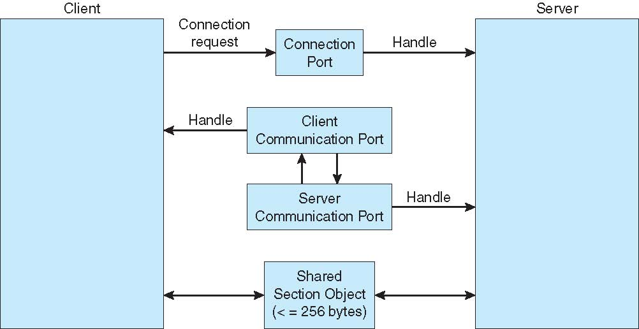
Local Procedure Calls in Windows

Slide 87
3.6 Communications in Client-Server Systems
Sockets
Remote Procedure Calls
Pipes
Remote Method Invocation (Java)
Remote Method Invocation (Java)

Slide 88
Sockets
A socket(套接字) is defined as an endpoint for communication
Concatenation of IP address and port – a number included at start of message packet to differentiate network services on a host
The socket 161.25.19.8:1625 refers to port 1625 on host 161.25.19.8
Communication consists between a pair of sockets
All ports below 1024 are well known, used for standard services
Special IP address 127.0.0.1 (loopback) to refer to system on which process is running

Slide 89
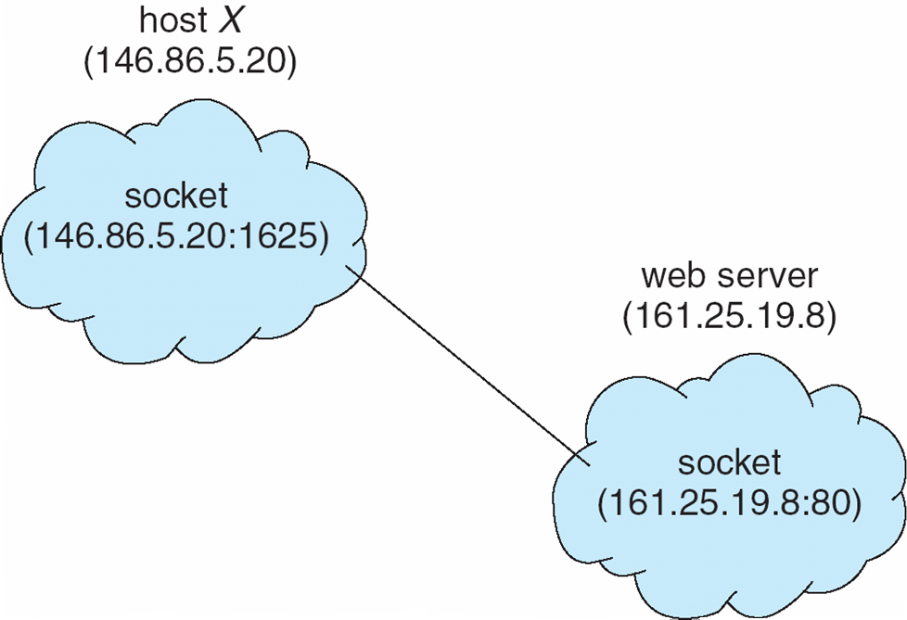
Socket Communication

Slide 90
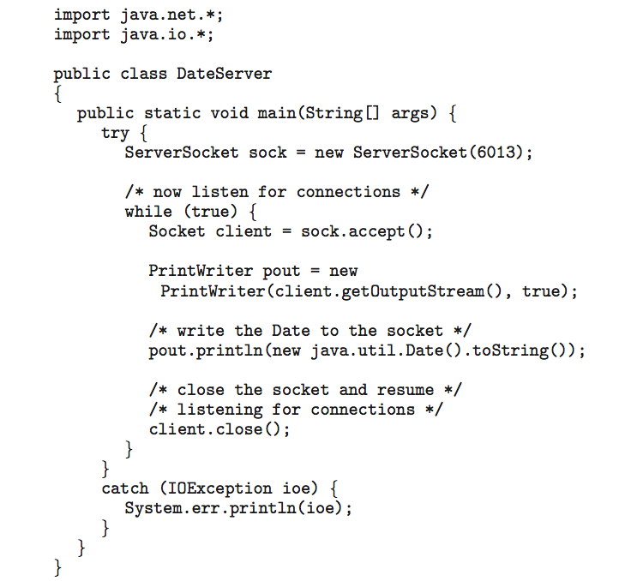
Sockets in Java
Three types of sockets
Connection-oriented (TCP)
Connectionless (UDP)
MulticastSocket class– data can be sent to multiple recipients
Consider this “Date” server:

Slide 91
Remote Procedure Calls
Remote procedure call (RPC，远程过程调用) abstracts procedure calls between processes on networked systems(跨越网络，调用远程系统中的过程，这里的过程相当于子程序)
Again uses ports(IDs) for service differentiation
Stubs(存根) – client-side proxy for the actual procedure on the server
The client-side stub locates the server and marshalls the parameters(参数序列化)
The server-side stub receives this message, unpacks the marshalled parameters(参数反序列化), and performs the procedure on the server
On Windows, stub code compile from specification written in Microsoft Interface Definition Language (MIDL)
Notes:
marshall 编组，整理，分堆，排列

Slide 92
Remote Procedure Calls (Cont.)
Data representation handled via External Data Representation (XDL，外部数据表示) format to account for different architectures
Big-endian and little-endian
Remote communication has more failure scenarios than local
Messages can be delivered exactly once rather than at most once
OS typically provides a rendezvous (or matchmaker) service to connect client and server

Slide 93
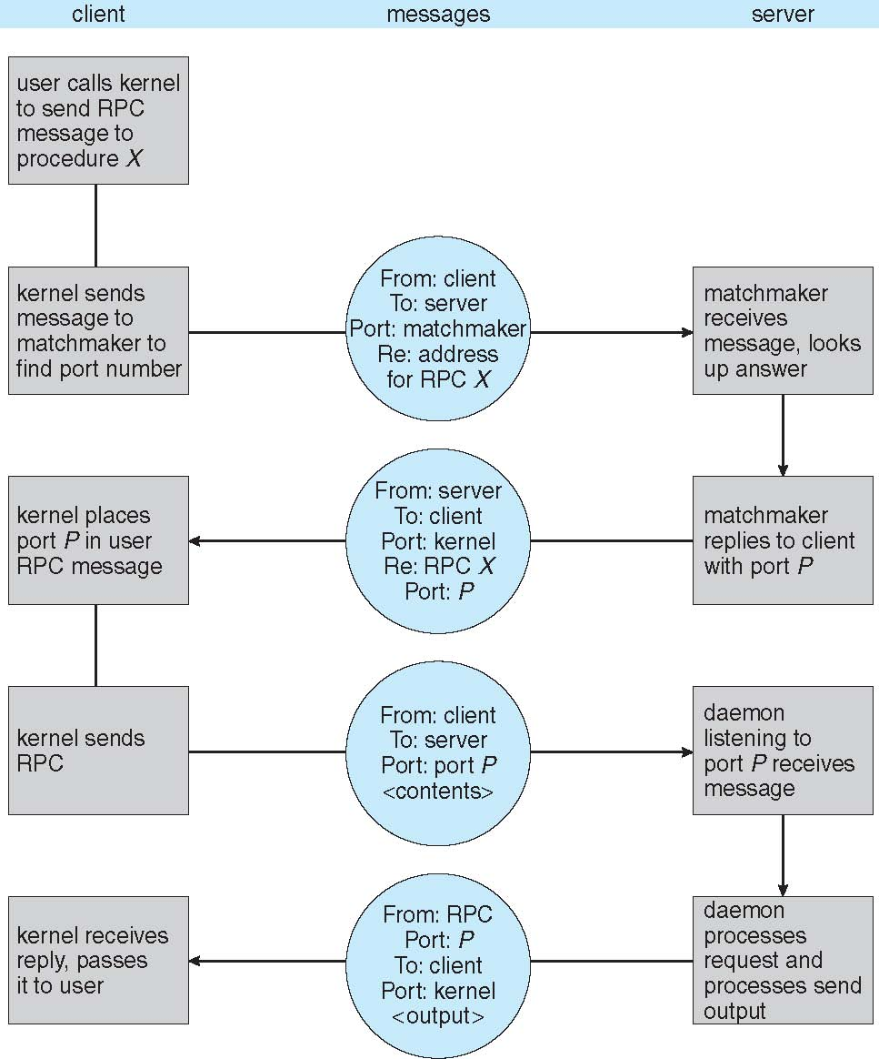
Execution of RPC

Slide 94
Pipes(管道)(OSC9 & OSC10)
Acts as a conduit allowing two processes to communicate
Issues:
Is communication unidirectional or bidirectional?
In the case of two-way communication, is it half or full-duplex?
Must there exist a relationship (i.e., parent-child) between the communicating processes?
Can the pipes be used over a network?
Ordinary pipes(普通管道) – cannot be accessed from outside the process that created it. Typically, a parent process creates a pipe and uses it to communicate with a child process that it created.
Named pipes(命名管道) – can be accessed without a parent-child relationship.

Slide 95
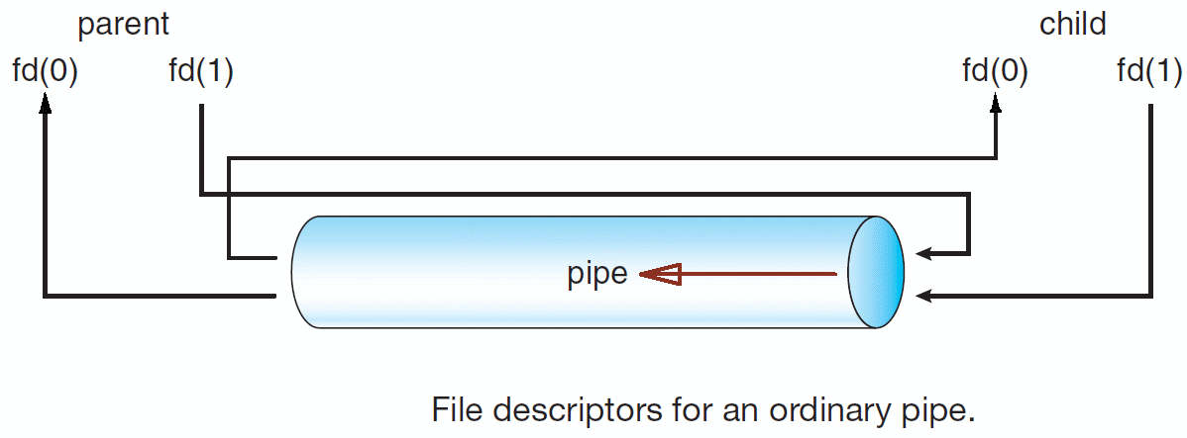
Ordinary Pipes(普通管道)
Ordinary Pipes allow communication in standard producer-consumer style
Producer writes to one end (the write-end of the pipe)
Consumer reads from the other end (the read-end of the pipe)
Ordinary pipes are therefore unidirectional
Require parent-child relationship between communicating processes
Windows calls these anonymous pipes
See Unix and Windows code samples in textbook(9th & 10th ed.)

Slide 96
Named Pipes(命名管道)
Named Pipes are more powerful than ordinary pipes
Communication is bidirectional
No parent-child relationship is necessary between the communicating processes
Several processes can use the named pipe for communication
Provided on both UNIX and Windows systems

Slide 97
Summary 1/4
A process is a program in execution, and the status of the current activity of a process is represented by the program counter, as well as other registers.
The layout of a process in memory is represented by four different sections: (1) text, (2) data, (3) heap, and (4) stack.
As a process executes, it changes state. There are five states of a process: (1) new, (2) ready, (3) running, (4) waiting(blocking), and (5) terminated.
A process control block (PCB) is the kernel data structure that represents a process in an operating system.

Slide 98
Summary 2/4
The role of the process scheduler is to select an available process to run on a CPU.
An operating system performs a context switch when it switches from running one process to running another.
The fork() and CreateProcess() system calls are used to create processes on UNIX and Windows systems, respectively.
When shared memory is used for communication between processes, two (or more) processes share the same region of memory. POSIX provides an API for shared memory.

Slide 99
Summary 3/4
Two processes may communicate by exchanging messages with one another using message passing. The Mach operating system uses message passing as its primary form of interprocess communication. Windows provides a form of message passing as well.
A pipe provides a conduit for two processes to communicate. There are two forms of pipes, ordinary and named. Ordinary pipes are designed for communication between processes that have a parent–child relationship. Named pipes are more general and allow several processes to communicate.
UNIX systems provide ordinary pipes through the pipe() system call. Ordinary pipes have a read end and a write end. A parent process can, for example, send data to the pipe using its write end, and the child process can read it from its read end，and vice verse. Named pipes in UNIX are termed FIFOs.

Slide 100
Summary 4/4
Windows systems also provide two forms of pipes—anonymous and named pipes. Anonymous pipes are similar to UNIX ordinary pipes. They are unidirectional and employ parent–child relationships between the communicating processes. Named pipes offer a richer form of interprocess communication than the UNIX counterpart, FIFOs.
Two common forms of client–server communication are sockets and remote procedure calls (RPCs). Sockets allow two processes on different machines to communicate over a network. RPCs abstract the concept of function (procedure) calls in such a way that a function can be invoked on another process that may reside on a separate computer.

Slide 101
进程地址空间(Address Space)

Slide 102
进程映像(Image)
对进程执行活动全过程的静态描述。由进程地址空间内容、硬件寄存器内容及与该进程相关的内核数据结构、内核栈组成
用户相关：进程地址空间（包括代码段、数据段、堆和栈、共享库……）
寄存器相关：程序计数器、指令寄存器、程序状态寄存器、栈指针、通用寄存器等的值
内核相关：
静态部分：PCB及各种资源数据结构
动态部分：内核栈(不同进程在进入内核后使用不同的内核栈)

Slide 103
进程的一些特性总结
并发性：任何进程都可以与其他进程“一起”向前推进
动态性：进程是正在执行的程序实例
进程是动态产生，动态消亡的
进程在其生命周期内，在三种基本状态(不考虑挂起时)之间转换
独立性：进程是资源分配的一个独立单位。例如，各进程的地址空间相互独立
交互性：指进程在执行过程中可能与其他进程产生直接或间接的关系
异步性：每个进程都以其相对独立的、不可预知的速度向前推进
进程映像：程序 + 数据 + 栈(用户栈、内核栈) + 堆 + PCB

Slide 104
本章重要概念
进程
进程状态及状态转换
进程运行(创建及终止进程)
进程控制块(PCB)
进程地址空间
进程上下文环境及其切换
进程间通信(IPC)

Slide 105
End of Chapter 3: Processes

